Slide 1
How to Succeed in
District 7020’s
Club of the Month Program

Slide 2
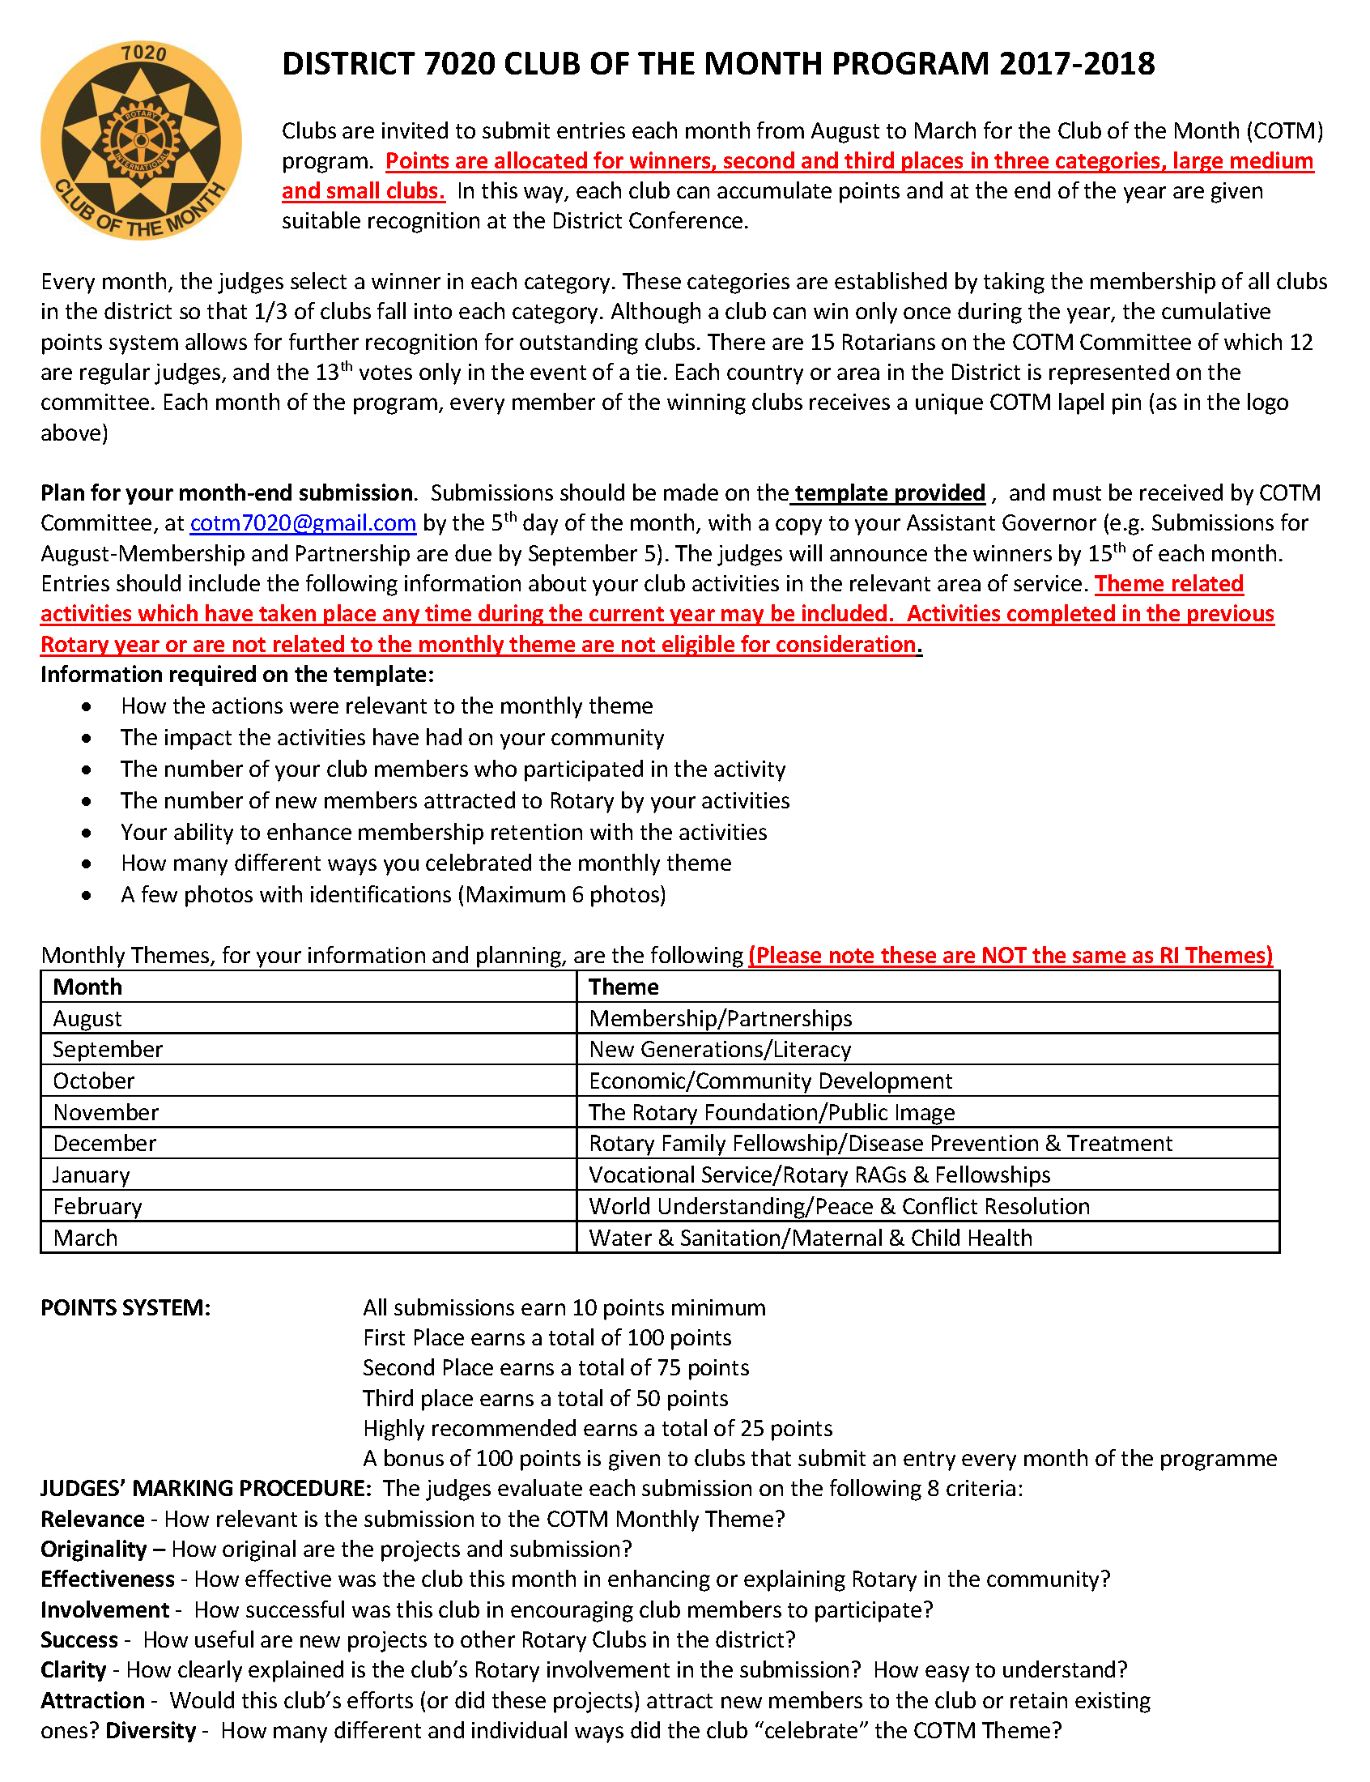
Please have a copy of the following documents to hand as you participate in this presentation:
Program
Description

Slide 3
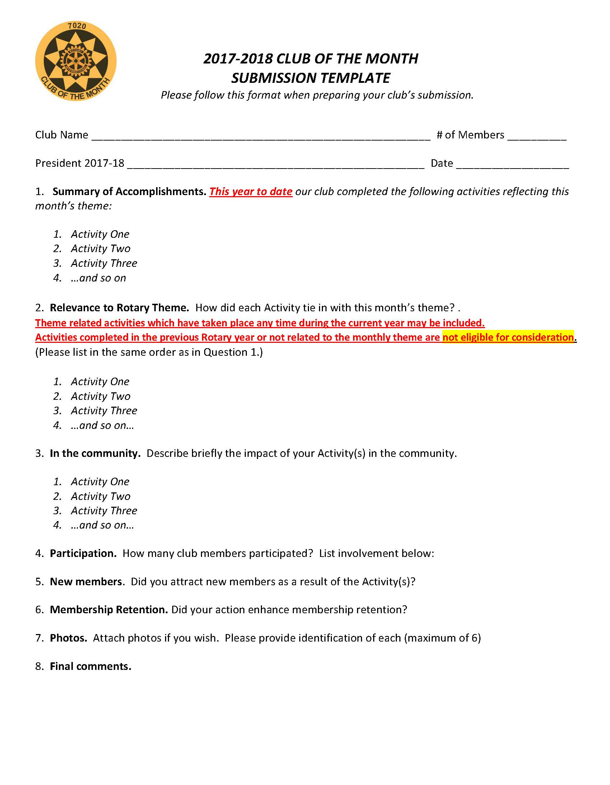
Please have a copy of the following documents to hand as you participate in this presentation:
Submission
Template

Slide 4
Let’s test your knowledge!
When does Rotary International celebrate “Youth Service Month”?
In which month should clubs submit their “New Generations” activities?

Slide 5
Rotary International celebrates “Youth Service Month” in MAY
COTM celebrates its Monthly Theme
“New Generations” in SEPTEMBER
Your club’s New Generations activities can only be considered if they are included in the SEPTEMBER submission (due October 5). It does not matter when, during the year, your club
has undertaken the activity

Slide 6
The Judges – What they look for
Relevance - How relevant is the submission to the COTM Monthly Theme?
Originality – How original are the projects and submission?
Effectiveness - How effective was the club this month in enhancing or explaining Rotary in the community?
Involvement - How successful was this club in encouraging club members to participate?
Success - How useful are new projects to other Rotary Clubs in the district?
Clarity - How clearly explained is the club’s Rotary involvement in the submission? How easy to understand?
Attraction - Would this club’s efforts (or did these projects) attract new members to the club or retain existing ones?
Diversity - How many different and individual ways did the club “celebrate” the COTM Monthly Theme?

Slide 7
When completing your submission, think like a judge!
Short but descriptive sentences
Pay attention to the member involvement and community support
Include all relevant activities – even the small ones
Keep a diary of your activities throughout the year and make sure they are included in the appropriate month

Slide 8
Do’s and Don’ts
DO:
Use the Template Form provided
Answer the questions clearly
Use bullet points
Include up to 6 photos
Ensure your submission is a reasonable size (not 10MB!!)
Submit either in MS Word or PDF
Submit to cotm7020@gmail.com

Slide 9
Do’s and Don’ts
DO NOT:
Include fancy headers, graphics or watermarks
Include high resolution photos
Include long details
Include more that 6 photos
Submit to the COTM Chair/Committee personally, use COTM7020@gmail.com
Submit late! Deadline is midnight on 5th of the month.

Slide 10
Do’s and Don’ts
There are occasions where clubs have submitted video links.
While our judges will make every effort to watch the videos, bear in mind they will be judging 30+ entries every month.
It is advisable to use video links only for activities which are specifically video-based. For example a television production.

Slide 11
Another question!
COTM theme for MARCH is:
Water & Sanitation/Maternal & Child Health.
Your club did a Water project in November,
is it too late now to include it in the March submission?

Slide 12
No, it must be included in the MARCH submission.
If your club submitted it in November it would have been ignored by the judges!
SUBMIT IT AGAIN IN MARCH!

Slide 13
The Points System
In each Category (Small, Medium Large clubs)
First Place: 100 Points
Second Place: 75 Points
Third Place: 50 Points
All other entries 10 Points
Bonus Points:
Clubs which submit every month during the program (8 months) receive 100 Bonus Points

Slide 14
FAQ’s
Can a club win the COTM Title more than once?
No
What if a club is considered a winner again by the judges?
The club will then receive 100 points towards the annual total
How many judges are there?
12 – representing every country/region in District 7020

Slide 15
Other Questions?
E-mail us – we are happy to help
We want to see you succeed!
Your success is our success
cotm7020@gmail.com

